Slide 1



Data Architecture for Surveillance and targeted advertising system
By Poh yu jie

Slide 2
Itinerary
Problems and Challenges
Data Architecture (Targeted Advertising)
Data Architecture (Abnormality Detection)
Security and Scalability
Future Enhancements and Conclusion

Slide 3
Problems
01
02
Problems and Challenges
Security Monitoring:
Using 200 cameras, the system will be provided with real-time video feed for immediate security responses
Targeted Advertising:
Using same cameras, identify the demographics of shoppers, allowing for personalized shopping experience
Data Architecture (Targeted Advertising)
Data Architecture (Abnormality Detection)
03
04
Scalable and Real Time:
Usage of modern data streaming tools and machine learning to process these video feeds and make decisions quickly
Data Management:
Data would be stored for a month for further data analysis needs to improve our systems
Security and Scalability
Future Enhancements and Conclusion

Slide 4

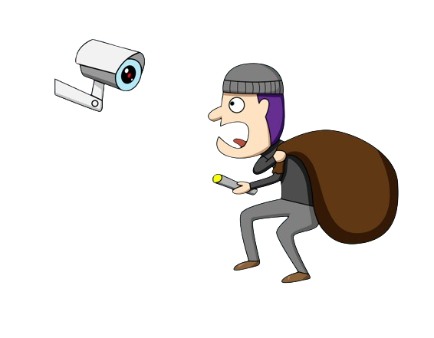

Problems and requirements
Problems and Challenges
Data Architecture (Targeted Advertising)
Data Architecture (Abnormality Detection)
Security and Scalability
Security threats must
be identified rapidly
Dwindling interests to
Be security guards
Adopting technology to
counteract lack of manpower
Future Enhancements and Conclusion
Straits Time Article: Link

Slide 5


Problems and requirements
Problems and Challenges
Data Architecture (Targeted Advertising)
Age | 20s
Gender | Female
Location | Level 1
Timing | 1300 hrs
Data Architecture (Abnormality Detection)
Security and Scalability
General demographics identified for targeted advertising
Future Enhancements and Conclusion
Real Time video feed provided

Slide 6


Challenges
Problems and Challenges
Real-Time Processing: System must identify security threats and demographics instantly, just like a human security officer
Data Architecture (Targeted Advertising)
Data Architecture (Abnormality Detection)
Scalability: Process massive video feed without performance
delay, with potential of adding more security cameras
x200
Security and Scalability
Privacy and Compliance: PDPA and other regulations must followed in collecting, processing and storing of personal information
Future Enhancements and Conclusion

Slide 7
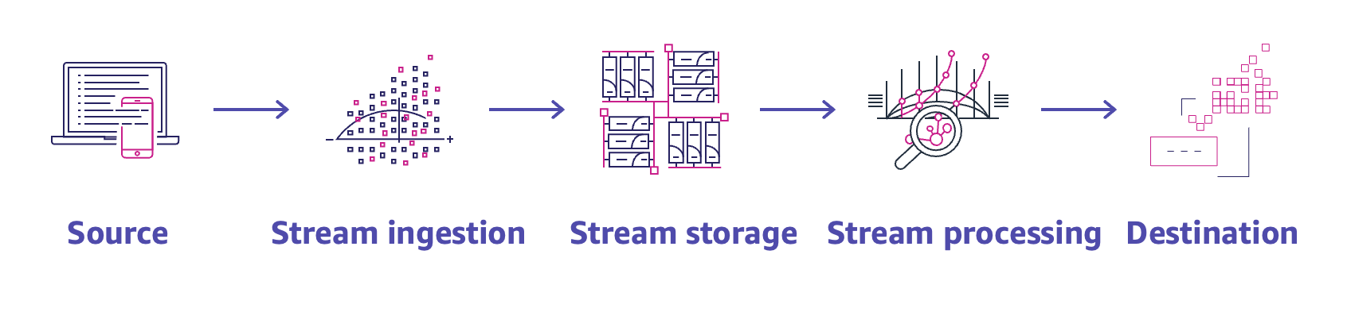
AWS modern data streaming architecture
Problems and Challenges
Data Architecture (Targeted Advertising)
Data Architecture (Abnormality Detection)
Security and Scalability
Future Enhancements and Conclusion
AWS Article: Link

Slide 8
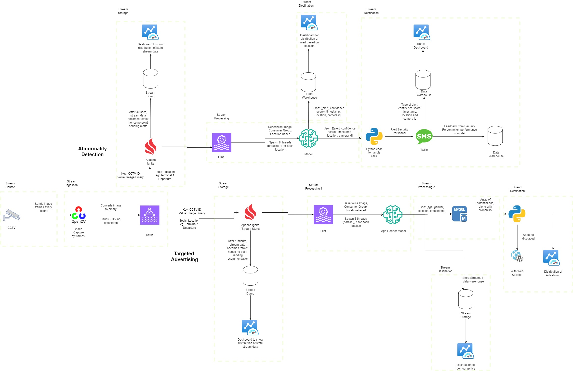
Data Architecture
Problems and Challenges
Data Architecture (Targeted Advertising)
Data Architecture (Abnormality Detection)
Security and Scalability
Future Enhancements and Conclusion

Slide 9




Stream Ingestion
Location: Level 1
Problems and Challenges
Data Architecture (Targeted Advertising)
Extract Frames at 1 second interval
Data Architecture (Abnormality Detection)
Images (as bytes), CCTV-ID, Timestamp, location
Security and Scalability
Location: Level 2
Future Enhancements and Conclusion

Slide 10



Stream Storage (Targeted Advertisements)
Problems and Challenges
Requires time to infer from image data
Data Architecture (Targeted Advertising)
Machine Learning Model
Data Architecture (Abnormality Detection)
Stream Data
Apache Ignite
Security and Scalability
Future Enhancements and Conclusion
Images older than 1 minute
Stream Dump
Analysis of delayed stream data

Slide 11

Stream Processing 1 (Targeted Advertisements)
Problems and Challenges
{max (age_count), max(gender_count), location, timestamp}
Threading
Data Architecture (Targeted Advertising)
Stream Data
(Level 1)
Age Gender Model
Data Architecture (Abnormality Detection)
{max (age_count), max(gender_count), location, timestamp}
Security and Scalability
Stream Data
Age Gender Model
Stream Data
(Level 2)
Python Code
{max (age_count), max(gender_count), location, timestamp}
Future Enhancements and Conclusion
Stream Data
(Level 3)
Threading
Age Gender Model

Slide 12
Stream Processing 2 (Targeted Advertisements)
Problems and Challenges
Data Architecture (Targeted Advertising)
Advertisement | Probability
Nike | 50%
Nintendo | 30%
Sony | 20%
Data Architecture (Abnormality Detection)
{max (age_count), max(gender_count), location, timestamp}
Output: Nike Ad
Security and Scalability
Advertisement database
SQL Query output
Future Enhancements and Conclusion

Slide 13

Stream Destination (Targeted Advertisements)
Problems and Challenges
Using Websockets
Data Architecture (Targeted Advertising)
Data Architecture (Abnormality Detection)
Nike Ad
Python Code
Security and Scalability
Future Enhancements and Conclusion
Data Warehouse
Analysis of demographics and ads shown

Slide 14
Stream Storage (Abnormality Detection)
Problems and Challenges
Requires time to infer from image data
Data Architecture (Targeted Advertising)
Machine Learning Model
Data Architecture (Abnormality Detection)
Stream Data
Apache Ignite
Security and Scalability
Future Enhancements and Conclusion
Images older than30 seconds
Stream Dump
Analysis of delayed stream data

Slide 15
Stream Processing (Abnormality Detection)
Problems and Challenges
{fire:10%, robbery: 99%, location, timestamp}
Threading
Data Architecture (Targeted Advertising)
Stream Data
(Level 1)
Abnormality Detection Model
Data Architecture (Abnormality Detection)
{fire:10%, robbery: 99%, location, timestamp}
Security and Scalability
Stream Data
Abnormality Detection Model
Stream Data
(Level 2)
Python Code
{fire:10%, robbery: 99%, location, timestamp}
Future Enhancements and Conclusion
Stream Data
(Level 3)
Threading
Abnormality Detection Model

Slide 16

Stream Destination (Abnormality Detection)
Problems and Challenges
Using Twilio
Security Personnel arrive at scene
Data Architecture (Targeted Advertising)
Data Architecture (Abnormality Detection)
Nike Ad
Python Code
Security and Scalability
Future Enhancements and Conclusion
Data Warehouse
Analysis of confidence score and abnormalities reported

Slide 17



Security and Privacy Considerations
Problems and Challenges
Data Architecture (Targeted Advertising)
Real-Time Processing: Images are processed in real time, hence we do not store images of people, complying with PDPA
Data Architecture (Abnormality Detection)
Encrypted Messages: Security Staff receives encrypted messages, role-based access further enhances security
Security and Scalability
Future Enhancements and Conclusion
AWS Cloud: Provides configurable firewalls for us to meet our security needs

Slide 18

Scalability and efficiency
Problems and Challenges
Data Architecture (Targeted Advertising)
Choice of Tech Stack: scalability and efficiency. Flink provides stateful computations to handle millions of events per second.
Data Architecture (Abnormality Detection)
Security and Scalability
Pay-Per-Use model: Easily scale up or down our compute instances and storage needs to balance cost and performance
Future Enhancements and Conclusion

Slide 19
Future Enhancements
Edge Computing: Shifting computation to data source reduces latency and quicker response to threats and faster targeted advertisements
Utilizing Camera Location: If multiple cameras in area show high confidence score but not higher than threshold, we can accept the threat
CCTV-ID: 101
Location: Level 1
CCTV-ID: 102
Location: Level 1

Slide 20
Conclusions
An understanding of the problems and need for this data architecture
An in-depth run-through of the data architecture implementations
A formal thank you to the team for this amazing opportunity to brainstorm on this project

